Slide 1
UNIT 5.3
Facing sexualised behaviour
The BRIGHTER FUTURE project has been funded with support from the European Commission. This material reflects the views only of the authors, and the Commission cannot be held responsible for any use which may be made of the information contained therein.

Slide 2
The centrality of the school
Children spend a lot of time at school
Teachers can meet children with emotional suffering
Teachers can create trust relationships with children and recognize signals of distress
Children can express distress through Inappropriete behavior in the classroom

Slide 3
Sexualised behaviours in the classroom
Sexual abuse
Sexual abuse is the most difficult to detect because it is difficult for an adult to imagine
Behavior as language
Children often do not talk about sexual violence but express themselves through their behaviour.

Slide 4
What can teachers do?
A wide spectrum of teacher emotions
anguish
powerless
anger
…..

Slide 5
Key questions
How can they successfully manage their feelings and avoid becoming harmful?
What skills do teachers need to better cope with these sensitive situations?

Slide 6
What is important_1
to recognize
to understand that
what child sexual abuse is
short and long-term consequences for children
no child is born “bad”
inadequate behaviour could be a result of traumatic experiences
this child can be helped

Slide 7
What is important_2
to recognize
to learn that
their own emotions
To know how to manage them
they should not act alone
they should share their observations with the school management
They can activate a support network

Slide 8
What is child abuse_1
Child sexual abuse is the involvement of a child in sexual activities, even if not characterized by explicit violence.
It can be made by an adult who is almost always an authority figure for the child, both within the family and in non-family relationships (places of aggregation, sports activities, school).

Slide 9
What is child abuse_2
A sexual abuse can also be perpetrated on the child through
falsely playful and ambigous method, almost always by
an adult who has a significant relationship with the child
The affective relationship is exploited by using sexual
communication totally inappropriate, harmful to children.

Slide 10
What is child abuse_3
A false belief: child abuse can only occur in multi-problematic households and in deprived socio-cultural contexts.
Sexual abuse of children exists and is a widespread phenomenon.
It is a phenomenon that cuts across all social classes, regardless of ethnicity, level of education and economic conditions.

Slide 11
What is child abuse_4
It is always a confusing and destabilizing attack on the child’s personality and developmental pathway
Any gesture of violation of intimacy certainly produces discomfort in the immediate aftermath but will also have long-term consequences well through adulthood

Slide 12
Behaviours as indicators of sexual abuse
The child often uses behaviours instead of words to ask for help
S/he identifies people close to him/her to communicate the abuse in which s/he lives
The teacher is frequently the adult chosen by the abused child
S/he should have the ability to pick up these signals

Slide 13
Behavioural indicators of sexual abuse_1
1. Early and improper sexualization
age-abnormal knowledge of aspects of adult sexuality in children;
tendency to eroticize relationships as a means of receiving and giving affection;
compulsive search for sexualized games;
drawings with sexual content;
compulsive masturbation;
sexual requests to adults or peers;
…

Slide 14
Behavioural indicators of sexual abuse_2
2. Emotional distress
sudden crying, irritability and outbursts of anger, sudden mood swings, despair, anxiety, hyperactivity, insecurity, aggression;
sleep disorders (e.g. nightmares);
eating disorders;
excessive and inappropriate fears;
refusal to undress during sports activities;
speech and learning disorders;
sudden drop in performance, school phobia;
self-harming behavior;
...

Slide 15
Consequences of early trauma
Adverse events experienced in childhood can lead to serious social and cognitive fragility in children
They increease likelihood of developing psychopathologies in adulthood.
The earlier the trauma is addressed with protective interventions, the more it will be possible to guarantee a healthy adulthood

Slide 16
Sexualisation?_1
In the field of sexualization there are so-called ‘normal’ behaviors
playing doctor
imitation and role-playing games (kissing or flirting)
comparing various intimate parts
occasional masturbation as an exploratory and/or consolatory act

Slide 17
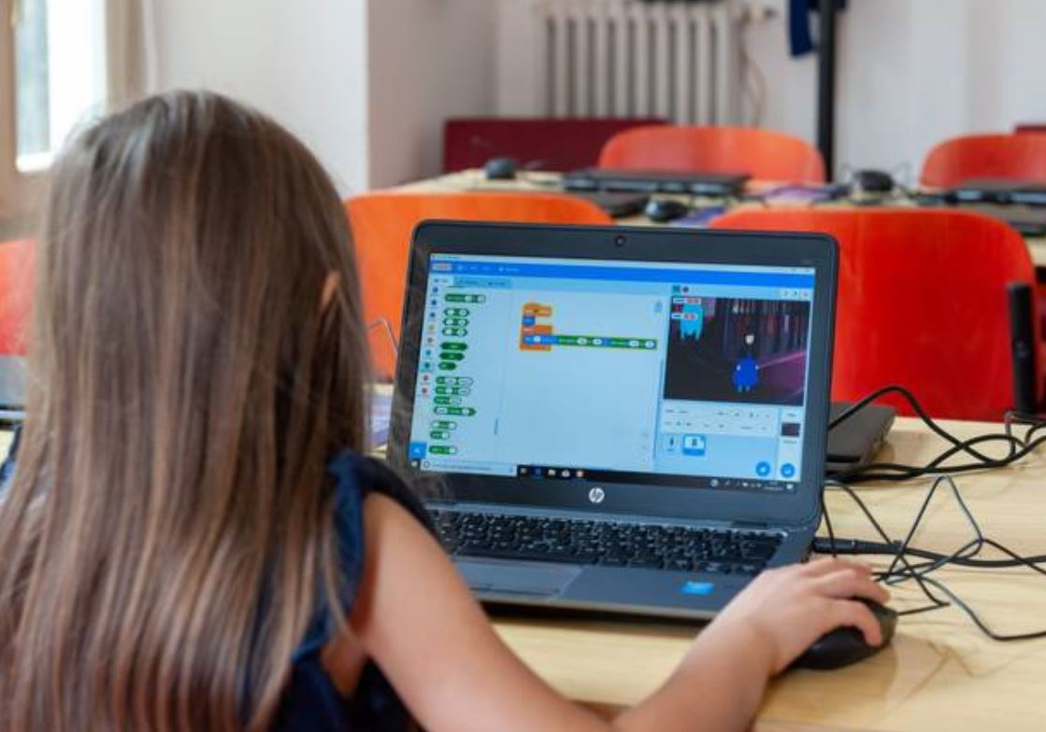
Sexualisation?_2
Inappropriate experiences
Sexual abuse
viewing pornographic sites
watching sex games
Possible behaviors
strong early sexual knowledge
sexually oriented drawings
sexualized behavior that creates embarrassment

Slide 18
Teacher’s emotions
Sexual abuse is unthinkable: a child can’t be sexually abused by an adult close to him/her
The emotions involved are generally painful and unpleasant: distress, feelings of inadequacy, frustration, helplessness, failure, anger, resentment, and disgust.

Slide 19
Teacher’s emotions in cases of suspected sexual abuse_1
Emotional defense strategies
DENIAL: refusal to recognize the problem even when the signs are obvious, (it’s not true”, “I didn’t notice”, “it’s not my responsibility”).
EMOTIONAL DISTANCE: indifference to what is acknowledged, e.g. “‘it’s not us who have to deal with it, it happens, I have so many other problems to think about”‘.
COLLUSION: is allying oneself with the adult instead of the child, typical of partners of abusers.

Slide 20
Teacher’s emotions in cases of suspected sexual abuse_2
Emotional defense strategies
IDENTIFICATION with the VICTIM: the teacher is emotionally too close to the child, and feels powerlessness, despair, fear, and anger of such strength that he cannot perceive and act effectively.
IDENTIFYING WITH THE AVENGER: The desire to do justice and protect the child leads the teacher to step out of their role, creating confusing situations both inside and outside the school.

Slide 21
Networking as a source of support_1
It is crucial NOT TO ACT ALONE.
Emotional reactions that can arise and possible protective intervention are complex
teacher can SHARE the child’s situation and their own management difficulties with their school manager/superior in order to understand how to deal with the situation.
If the child is already followed and known to other professionals or services in the region (psychologists, social service, etc.) teachers should share their observations with these professionals and activate a network.

Slide 22
Networking as a source of support_2
Networking for:
teacher’s own emotions management, for example with respect to anxiety or frustration.
Design of intervention strategies with professionals to help the child feel better (neuropsychiatrists, psychologists, social services, educational day care centers).
If the indicators are very worrisome the teacher can ask for advice in order to make a report to proper authorities.

Slide 23
Collaboration is necessary to build an integrated intervention solution to better assist and support children with traumatic experiences

