Slide 1
UNIT 3
Negatieve
Jeugdervaringen (ACE)
The BRIGHTER FUTURE project has been funded with support from the European Commission. This material reflects the views only of the authors, and the Commission cannot be held responsible for any use which may be made of the information contained therein.

Slide 2
Doelstellingen
Conceptualisatie van Negatieve Jeugdervaringen/ ACEs
Theoretische benadering op de effecten van negatieve jeugdervaringen

Slide 3
Negatieve jeugdervaringen
BREAKING THE ICE
Wat is volgens jou een negatieve jeugdervaring?
Notes:
Work in small groups:
Discuss and list different forms of ACE
It is quite possible that at first students will only mention individual or family unit aspects. To broaden the view, questions such as "Do you think that living in an area where there is war or having to leave the country for this reason could be added to the list?", "What about being bullied?" can be used.

Slide 4
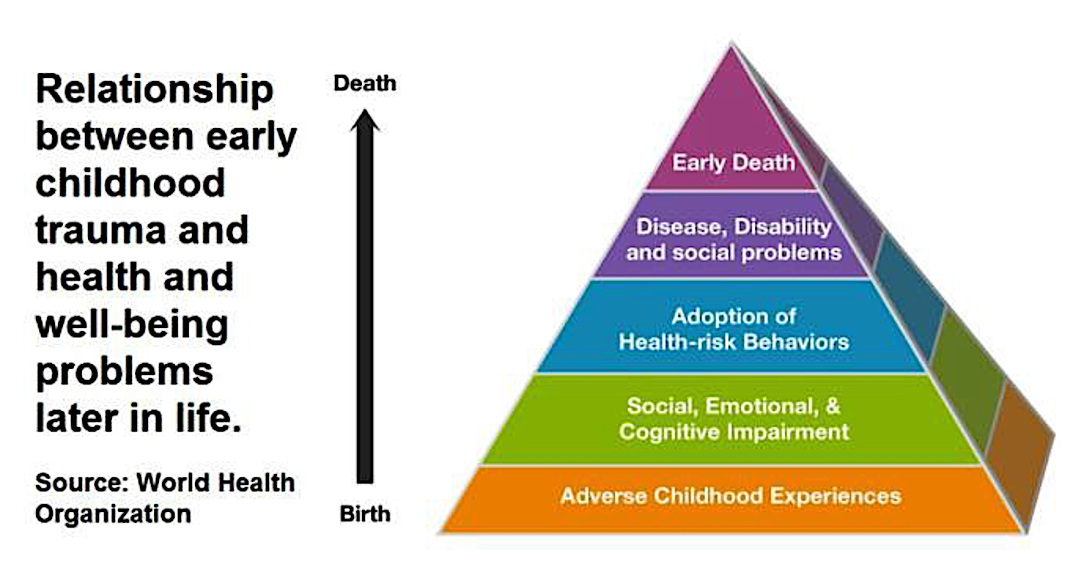
Invloed van negatieve jeugdervaringen op de levensloop
Notes:
The idea that traumatic experiences in childhood can have lasting consequences on people's health, social adjustment and well-being is widespread. Film and television fiction, for example, are full of examples of socially maladjusted people who experienced difficult situations in early life.
Starting in 1994, a large study conducted in the United States with a sample of more than 17,000 individuals found a clear association between the accumulation of experiences of adversity before the age of 18 and negative outcomes in terms of physical and mental health in adulthood (Felitti et al., 1998).

Slide 5
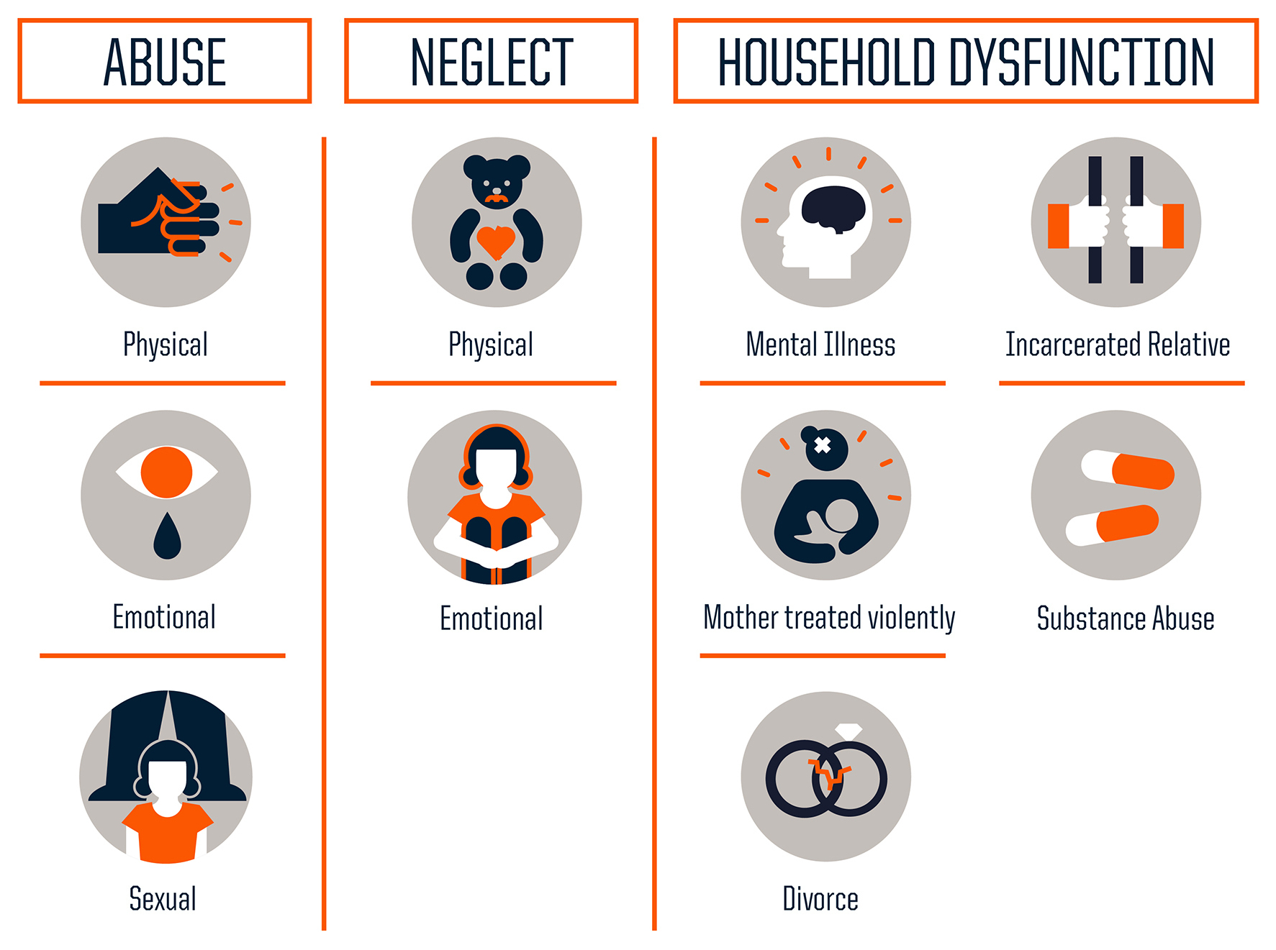
Klassieke conceptualisatie van ACE
Source: Centers for Disease Control and Prevention
Credit: Robert Wood Johnson Foundation
Notes:
The term ACEs was coined to identify those experiences that could have a negative impact on people's development and thus on their health and well-being throughout life. Initially, ACEs were classified into 10 categories grouped along three axes (Anda & Felitti, 2010):
Abuse
Emotional abuse
Physical abuse
Sexual abuse
Household Challenges
Mother treated violently
Household member was an alcoholic or drug user
Household member was imprisoned
Household member was chronically depressed, suicidal, mentally ill, in a psychiatric hospital
Not raised by both biological parents
Neglect
Emotional neglect
Physical neglect

Slide 6
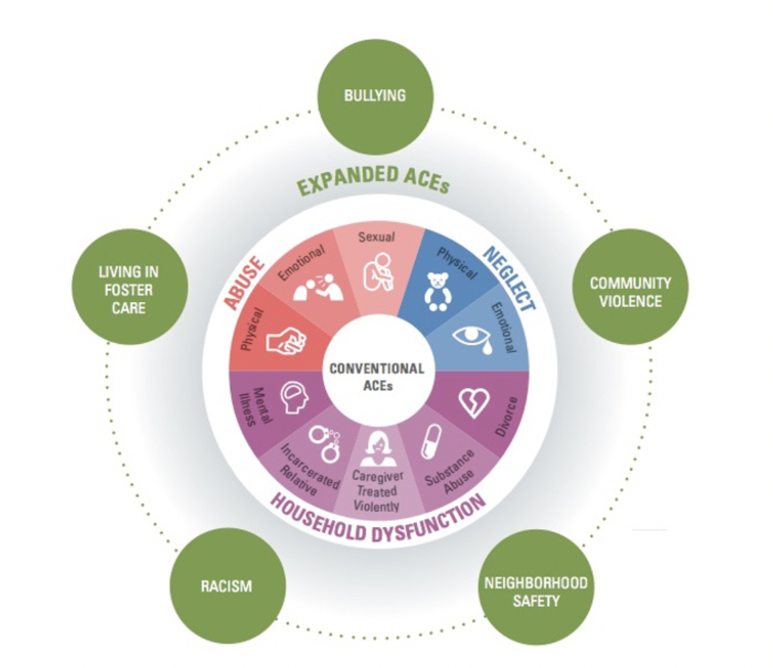
Het concept uitbreiden
“Human life cannot be studied without taking into account both how individuals are situated within and constrained by social structures and how those individuals construct an understanding of and impose meaning on the world around them.”
Dressler (2001: 455)
Source: Cronholm et al. (2015)
Notes:
Some authors consider that the term ACEs needs to be expanded to include other factors such as neighborhood violence, homelessness, foster care, bullying, and racism.
Research on the prevalence and impact of ACEs has highlighted:
the high prevalence of ACEs in the general population: in the initial study, with a sample of over 17,000 individuals, 67% had experienced at least one ACE; 12.6%, one in eight, had four or more;
that the accumulation of ACEs during childhood is a strong predictor of physical and mental health problems in adulthood: the higher the number of ACEs, the greater the likelihood of experiencing chronic depression, suicide attempts, risky behaviours, incarceration, premature death.
This is why in many countries the concept of ACEs has informed public policy. However, it is important to note that two children who experience the same type of adversity may respond in distinct ways: one may recover quickly without significant distress, whereas another may develop posttraumatic stress disorder or have their wellbeing seriously affected in the long term.

Slide 7
Kritiek op het concept van ACEs
Focus ligt op individuele en gezinsaspecten
Determinisme
Onderwaardering van agency and individuele mogelijkheden
Notes:
While the very concept of ACEs has contributed greatly to identifying and making visible early experiences of adversity and their possible effects, there are also a growing number of critical voices. There are two main axes of criticism:
The assessment and identification of ACEs focuses on individual and household aspects. While it is true that the incorporation of other social factors in what we have called the expanded concept of ACEs opens the focus to structural, social and cultural aspects, in practice, household-centred questionnaires are still mostly used for assessment.
Identifying the relationship between early adversity and certain situations in adulthood often leads to a deterministic and fatalistic view of people, which ignores their capacities, potential and agency.

Slide 8
Benaderingen ACEs
Hechtingstheorie
Neurowetenschappelijke benadering
Ecologische Theorie
Notes:
Quantitative studies measuring the prevalence of ACEs in the population and their correlation with difficulties in adulthood do not provide an explanation of how ACEs influence people's development and adult experience. In the following, we will look at the main approaches that try to answer what are the mechanisms by which ACEs influence development at different levels.

Slide 9
Hechtingstheorie
Hechtingstheorie
John Bowlby (1969)
Het idee van de theorie is dat primaire verzorgers die beschikbaar zijn en responsief reageren op de behoeften van het kind ervoor zorgen dat het kind een gevoel van veiligheid ontwikkelt. Volgens Bowlby is dit gebaseerd op het vormen van vroegtijdige affectieve relaties tussen kind en verzorger die psychologisch welzijn faciliteren, wat van invloed is op de ontwikkeling in zowel de kindertijd als daarna.
Notes:
Attachment Theory
Attachment theory was first formulated by John Bowlby (1969) and has been one of the most important, guiding, persuasive theories of the 20th century until today. Attachment theory has shaped child psychiatry, psychology, child care and the understanding of various problems of children and adolescents.
The central idea of the theory is that primary caregivers who are available and responsive to an infant's needs enable the child to develop a sense of security. According to Bowlby, it is based on the establishment of affective bonds, of early relationships between infants and their caregivers that allow for a good psychological and healthy well-being, which will affect the person’s development in infancy, childhood and adult life.
The theory proposes that during the first year of a person's life, the attachment between the baby and his or her caregiver is established, which enables the child to feel secure. The attachment bond is defined as permanent and allows for the establishment of a relationship of closeness between the people involved. The following graphic shows how the attachment cycle works during the first months of life [GRAPHIC].
Attachment theory emphasizes the impact of primary caregivers and children relationships on psychological functioning. It states that it is through this relationship that children form an idea of themselves (as competent and worthy of love or as incompetent and defective) and of others (as potential supporters or threats), as they develop an ‘internal working model’ (or template) for subsequent relationships. Children then automatically implement these models when engaging in everyday circumstances.

Slide 10
Hechtingsstijlen
Hechtingstheorie
The Strange Situation (Ainsworth, 1969)
Notes:
Watch this video. The video represents four styles of attachment as explained by Ainsworth:
The Strange Situation (Ainsworth, 1969)
Ainsworth and her colleagues (1978) identified 3 patterns of attachment behaviour:
Secure attachment is most often fostered by consistently sensitive and responsive caregiving. Securely attached children are able to regulate their distress and know they can show their needs and feelings and won’t be rejected. They are attached to their parent or caregiver and enjoy being with them, but are secure enough to explore the world.
Insecure avoidant attachment tends to occur when the caregiver finds it difficult to accept or respond sensitively to the infant’s needs, and caregiving fluctuates between responsive and rejecting. Children come to see themselves as neither loved nor loveable. Anxiety that any show of need or emotion may drive their caregiver away leads them to shut down their feelings and stop seeking closeness or expressing emotion.
Insecure ambivalent attachment is linked to inconsistent caregiving that fluctuates between responsive and rejecting, and where love and affection are inconsistently given, based on factors the child does not understand. This generates high levels of anxiety and insecurity in the child. Children with this attachment style may seem clingy, and more frequently seek the attention of their parent or caregiver, yet may reject that attention when it is offered.
A fourth style of attachment was added later to the list: the disorganised attachment. This form of attachment is attributed to atypical caregiver behaviours that often exhibit contrasting and unpredictable reactions. It usually comes from situations where caregivers are mentally ill or erratic, and is linked to verbal, physical, or sexual abuse. The child is emotionally and physically dependent on someone who is also a source of distress or fears. The child then acts conflicted towards their caregiver. They may at first run to them, but then seem to change their mind and either run away or act out against their caregivers.

Slide 11
Kritiek op de Hechtingstheorie
Reductionisme en monocausaliteit (Korstanje, 2008; Waters et al, 2002)
Determinisme (Saunders et al., 2015)
Het dynamische van hechting (Groh et al., 2014)
Cultuurverschillen
Notes:
Criticism of Attachment Theory
Monocausality: Reduce the parent-child relationship to one dimension, that also is connected to a casual relation with specific psychiatric pathologies. The child’s attachment to the caregiver (the caregiver as a “secure base” who provides safety and security) is only one specific component of the caregiver-child relationship. This can overshadow or dismiss other aspects of the parent-child relationship such as the child’s temperament and biological constitution, the cognitive stimulation she/he has been provided, the caregiver’s modelling of emotion regulation and impulse control, disciplinary techniques they use, etc. In addition, it fails to recognise the influences of other factors, such as social class, gender, ethnicity, and culture on personality development.
Determinism: The theory reproduces an essentialism based on the idea that something that happened to us, often when we were very young, can have such a profound effect on our later personality and behaviour. Some studies have shifted the focus from the cause-effect relationship in the maternal bond to how the latter has been symbolically constructed by the subject in adulthood (Korstanje, 2008; Waters et al, 2002).
Multiplicity of attachments: Attachment theory usually refers to the primary attachment figure, usually the mother. However, children have attachments and interact with other people other than their mothers, and these relationships have an important impact on the children’s lives as they get older (Saunders et al., 2015).
Dynamism: Attachment and the styles resulting from it are not fixed, but are constantly developing with time and experience (Mercer, 2006). It was assumed that an individual’s attachment style remains stable across the lifespan, however, there is no evidence of continuity from infant attachment classification to adult attachment classification (Groh et al., 2014). Most of the studies have focused on children under 6 or 7 years.
Cultural differences and attachment behaviour: It is necessary to bear in mind that attachment types vary substantially between societies. In recent years, although many researchers around the world have applied these scales in their societies, the results were quite contrary to those reached by both Ainsworth and Bowlby.

Slide 12
Neurowetenschappelijke benadering
Langdurige blootstelling aan een stressvole omgeving
Effect op de structuur en functies van
neurale stress-regulerende circuits
Beïnvloeden stressgevoeligheid en emotieregulatie op latere leeftijd
Notes:
Neuroscience approach
Neuroscientists use another approach to explain how children exposed to ACEs early in life are at increased risk for developmental difficulties, affecting both cognitive and emotional adjustment.
Neuroscientists consider there is clear evidence that ACEs are associated with enduring effects on the structure and function of neural stress-regulatory circuits such as the hippocampus or the amygdala and alter stress sensitivity and emotion regulation in later life.
When a child’s stress response systems are activated within an environment of supportive relationships with adults, these physiological effects are softened and brought back down to baseline. The result is the development of healthy stress response systems. However, if the stress response is extreme and long-lasting, and softening relationships are unavailable to the child, the result can be damaged, weakened systems and brain, with long-term repercussions.
When a child experiences strong, frequent, and/or prolonged adversity—such as physical or emotional abuse, chronic neglect, caregiver substance abuse or mental illness, exposure to violence, and/or the accumulated burdens of family economic hardship—without adequate adult support. This kind of prolonged stress can harm the body and brain, and cause lifelong health problems.
When toxic stress response occurs continuously, it can impact on the growth, development and physical and mental health. The more adverse experiences in childhood, the greater the likelihood of developmental delays and later health problems. Research also indicates that supportive, responsive relationships with caring adults as early in life as possible can prevent or reverse the harmful effects of toxic stress response.

Slide 13
Toxic Stress
What is toxic stress?
Source: Center on the Developing Child - Harvard University
Notes:
Watch this video: https://developingchild.harvard.edu/science/key-concepts/toxic-stress/
We can distinguish three kinds of responses to stress: positive, tolerable, and toxic (see figure).
Positive stress response is the body’s response to temporary stress. For example, the first day with a new caregiver or receiving an injected immunization might lead to this kind of response.
Tolerable stress response activates the body’s alert systems to a longer and more serious stress, such as the loss of a figure of reference. When there is support to, the body can return to the normal state more easily.
Toxic stress response can occur when a child experiences strong, frequent, and/or prolonged adversity—such as physical or emotional abuse, chronic neglect, caregiver substance abuse or mental illness, exposure to violence, and/or the accumulated burdens of family economic hardship—without adequate adult support. This kind of prolonged stress can harm the body and brain, and cause lifelong health problems.
When toxic stress response occurs continuously, it can impact on the growth, development and physical and mental health. The more adverse experiences in childhood, the greater the likelihood of developmental delays and later health problems. Research also indicates that supportive, responsive relationships with caring adults as early in life as possible can prevent or reverse the harmful effects of toxic stress response.

Slide 14
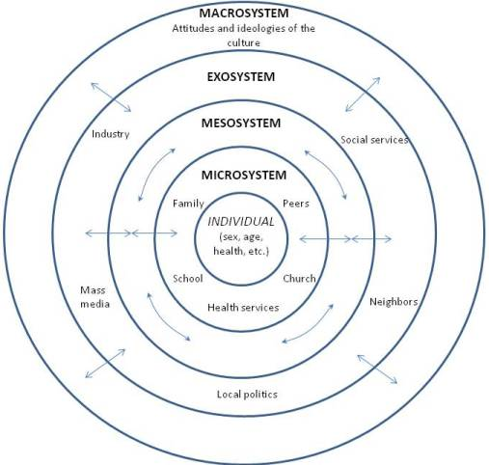
Ecologische Theorie
“The developmental potential of a child-rearing setting is enhanced by the number of supportive links between that setting and other contexts in which the child and the adults responsible for the child's care are embedded”
(Bronfenbrenner, 1985: 51-52)
Notes:
The social ecology models provide a wider frame both to assess the impact of early adversity and the ways to address it. The classical ecological theory developed by Bronfenbrenner (1979) allows consideration of factors that impact on development and the life course, positively or negatively, beyond the family unit. Bronfenbrenner's model depicts four systems:
the microsystem: comprises the interactions and relationships within the household, day-care centres or playgrounds.
the mesosystem: is the interlinked system of microsystems in which a person participates—for example, linkages between family and school.
the exosystem: refers to other environments that affect the child indirectly (where the child is not an active participant), like the parents’ work environments, sibling’s school, or local government.
the macrosystem: encompasses broader social characteristics, including norms, customs, beliefs and political structures.
Ecological theory allows us to understand how children's development and wellbeing depends on multiple factors, some of them outside the spaces they inhabit. It also helps to conceptualise early adversity not as something definitive and irreparable, but as part of a universe that can be repaired or integrated by the rest of the elements of the system. Thus, for example, suffering experiences of early adversity in the family unit (microsystem) is different when there are or when there are no public or educational policies (exosystem) that facilitate the repair and overcoming of its possible effects.

Slide 15
Samenwerken (1)
The danger of the single story
Chimamanda Ngozi Adichie (2009)
Wat voor "single stories" ben jij mee opgegroeid?
Heeft iemand ooit unieke verhalen over jou gebruikt?
Hoe heeft dit invloed gehad op jouw relatie tot jezelf, de mensen om je heen, en de wereld?
Heb jij ooit een uniek verhaal gebruikt?
Notes:
Watch the TED talk by Chimamanda Ngozi Adichie and in group answer the questions below:
· What are the "single stories" you grew up with?
· Has anyone ever used unique stories about you?
· How has this thing shifted your relationship to yourself, to people around you, and to the world you live in?
· Do you have ever used unique stories?
The group reflects on the use and effects of unique stories and appreciate human diversity in all its richness and complexity.
Tools: https://www.ted.com/talks/chimamanda_ngozi_adichie_the_danger_of_a_single_story

Slide 16
Samenwerken (2)
Geleide fantasie: “The mover”
Adapted and translated from: Palacios, J.; León, E.; Sánchez-Sandoval, Y.; Amorós, P.; Fuentes, N.; Fuertes, J. (2006). Programa de formación para la adopción nacional. Junta de Andalucía. Consejería para la Igualdad y Bienestar Social.

Slide 17
Referenties
Ainsworth, M. D. S., Blehar, M. C., Waters, E., & Wall, S. (1978). Patterns of attachment: A psychological study of the strange situation. Lawrence Erlbaum
Bowlby, J. (1969). Attachment and Loss, Vol. 1: Attachment. Attachment and Loss. New York: Basic Books
Bronfenbrenner, U. (1979). The Ecology of Human Development: Experiments by Nature and Design. Harvard University Press.
Dressler W. W. (2001). Medical anthropology: toward a third moment in social science?. Medical anthropology quarterly, 15(4), 455–465. https://doi.org/10.1525/maq.2001.15.4.455
Felitti VJ, Anda RF, Nordenberg D, Williamson DF, Spitz AM, Edwards V, Koss MP, Marks JS (1998). Relationships of childhood abuse and household dysfunction to many of the leading causes of death in adults. Am J Prev Med; 14:245–258
Felitti, V., & Anda, R. (2010). The relationship of adverse childhood experiences to adult medical disease, psychiatric disorders and sexual behavior: Implications for healthcare. In R. Lanius, E. Vermetten, & C. Pain (Eds.), The Impact of Early Life Trauma on Health and Disease: The Hidden Epidemic (pp. 77-87). Cambridge University Press.
Groh, A. M., Roisman, G. I., Booth-LaForce, C., Fraley, R. C., Owen, M. T., Cox, M. J., et al. (2014). IV. Stability of attachment security from infancy to late adolescence. Monographs of the Society for Research in Child Development, 79(3), 51–66.
Korstanje, M. (2008). Turismo y Crítica a la teoría de la Base segura en Bowlby. Revista Electrónica de Psicología Iztacala, 11(2), pp. 115-137.
Kandel, Eric R. (2012). Principles of Neural Science, Fifth Edition. McGraw-Hill Education. p. 5.
Mercer, J. (2006). Understanding attachment: Parenting, child care, and emotional development. Greenwood Publishing Group.
Shulman, Robert G. (2013). "Neuroscience: A Multidisciplinary, Multilevel Field". Brain Imaging: What it Can (and Cannot) Tell Us About Consciousness. Oxford
Slater, R. (2007). Attachment: Theoretical development and critique. Educational Psychology in Practice, 23(3), 205–219. https://doi.org/10.1080/02667360701507285
Waters, E.; Crowell, J.; Elliott, M.; Corcoran, D.; & Treboux, D. (2002). Bowlby's secure base theory and the social/personality psychology of attachment styles: Work(s) in progress. Attachment & Human Development, 4:2, 230-242. https://doi.org/10.1080/14616730210154216

Slide 18
NOTES
Adverse childhood experiences
Work in small groups
Discuss and list different forms of ACE
It is quite possible that at first students will only mention individual or family unit aspects. To broaden the view, questions such as "Do you think that living in an area where there is war or having to leave the country for this reason could be added to the list?", "What about being bullied?" can be used.
Impact of ACEs in human’s experience
The idea that traumatic experiences in childhood can have lasting consequences on people's health, social adjustment and well-being is widespread. Film and television fiction, for example, are full of examples of socially maladjusted people who experienced difficult situations in early life.
Starting in 1994, a large study conducted in the United States with a sample of more than 17,000 individuals found a clear association between the accumulation of experiences of adversity before the age of 18 and negative outcomes in terms of physical and mental health in adulthood (Felitti et al., 1998).
Classic conceptualisation of ACE
The term ACEs was coined to identify those experiences that could have a negative impact on people's development and thus on their health and well-being throughout life. Initially, ACEs were classified into 10 categories grouped along three axes (Anda & Felitti, 2010):
Abuse
Emotional abuse
Physical abuse
Sexual abuse
Household Challenges
Mother treated violently
Household member was an alcoholic or drug user
Household member was imprisoned
Household member was chronically depressed, suicidal, mentally ill, in a psychiatric hospital
Not raised by both biological parents
Neglect
Emotional neglect
Physical neglect
Expanding the concept
Some authors consider that the term ACEs needs to be expanded to include other factors such as neighborhood violence, homelessness, foster care, bullying, and racism.
Research on the prevalence and impact of ACEs has highlighted:
the high prevalence of ACEs in the general population: in the initial study, with a sample of over 17,000 individuals, 67% had experienced at least one ACE; 12.6%, one in eight, had four or more;
that the accumulation of ACEs during childhood is a strong predictor of physical and mental health problems in adulthood: the higher the number of ACEs, the greater the likelihood of experiencing chronic depression, suicide attempts, risky behaviours, incarceration, premature death.
This is why in many countries the concept of ACEs has informed public policy. However, it is important to note that two children who experience the same type of adversity may respond in distinct ways: one may recover quickly without significant distress, whereas another may develop posttraumatic stress disorder or have their wellbeing seriously affected in the long term.
Critique to the concept of ACEs
While the very concept of ACEs has contributed greatly to identifying and making visible early experiences of adversity and their possible effects, there are also a growing number of critical voices.
There are two main axes of criticism:
The assessment and identification of ACEs focuses on individual and household aspects. While it is true that the incorporation of other social factors in what we have called the expanded concept of ACEs opens the focus to structural, social and cultural aspects, in practice, household-centred questionnaires are still mostly used for assessment.
Identifying the relationship between early adversity and certain situations in adulthood often leads to a deterministic and fatalistic view of people, which ignores their capacities, potential and agency.
Approaches to ACEs
Quantitative studies measuring the prevalence of ACEs in the population and their correlation with difficulties in adulthood do not provide an explanation of how ACEs influence people's development and adult experience. In the following, we will look at the main approaches that try to answer what are the mechanisms by which ACEs influence development at different levels.

Slide 19
Attachment Theory
Attachment theory was first formulated by John Bowlby (1969) and has been one of the most important, guiding, persuasive theories of the 20th century until today. Attachment theory has shaped child psychiatry, psychology, child care and the understanding of various problems of children and adolescents.
The central idea of the theory is that primary caregivers who are available and responsive to an infant's needs enable the child to develop a sense of security. According to Bowlby, it is based on the establishment of affective bonds, of early relationships between infants and their caregivers that allow for a good psychological and healthy well-being, which will affect the person’s development in infancy, childhood and adult life.
The theory proposes that during the first year of a person's life, the attachment between the baby and his or her caregiver is established, which enables the child to feel secure. The attachment bond is defined as permanent and allows for the establishment of a relationship of closeness between the people involved. The following graphic shows how the attachment cycle works during the first months of life.
Attachment theory emphasizes the impact of primary caregivers and children relationships on psychological functioning. It states that it is through this relationship that children form an idea of themselves (as competent and worthy of love or as incompetent and defective) and of others (as potential supporters or threats), as they develop an ‘internal working model’ (or template) for subsequent relationships. Children then automatically implement these models when engaging in everyday circumstances.
Criticism of Attachment Theory
Monocausality: Reduce the parent-child relationship to one dimension, that also is connected to a casual relation with specific psychiatric pathologies. The child’s attachment to the caregiver (the caregiver as a “secure base” who provides safety and security) is only one specific component of the caregiver-child relationship. This can overshadow or dismiss other aspects of the parent-child relationship such as the child’s temperament and biological constitution, the cognitive stimulation she/he has been provided, the caregiver’s modelling of emotion regulation and impulse control, disciplinary techniques they use, etc. In addition, it fails to recognise the influences of other factors, such as social class, gender, ethnicity, and culture on personality development.
Determinism: The theory reproduces an essentialism based on the idea that something that happened to us, often when we were very young, can have such a profound effect on our later personality and behaviour. Some studies have shifted the focus from the cause-effect relationship in the maternal bond to how the latter has been symbolically constructed by the subject in adulthood (Korstanje, 2008; Waters et al, 2002).
Multiplicity of attachments: Attachment theory usually refers to the primary attachment figure, usually the mother. However, children have attachments and interact with other people other than their mothers, and these relationships have an important impact on the children’s lives as they get older (Saunders et al., 2015).
Dynamism: Attachment and the styles resulting from it are not fixed, but are constantly developing with time and experience (Mercer, 2006). It was assumed that an individual’s attachment style remains stable across the lifespan, however, there is no evidence of continuity from infant attachment classification to adult attachment classification (Groh et al., 2014). Most of the studies have focused on children under 6 or 7 years.
Cultural differences and attachment behaviour: It is necessary to bear in mind that attachment types vary substantially between societies. In recent years, although many researchers around the world have applied these scales in their societies, the results were quite contrary to those reached by both Ainsworth and Bowlby.
Neuroscience approach
Neuroscientists use another approach to explain how children exposed to ACEs early in life are at increased risk for developmental difficulties, affecting both cognitive and emotional adjustment.
Neuroscientists consider there is clear evidence that ACEs are associated with enduring effects on the structure and function of neural stress-regulatory circuits such as the hippocampus or the amygdala and alter stress sensitivity and emotion regulation in later life.
When a child’s stress response systems are activated within an environment of supportive relationships with adults, these physiological effects are softened and brought back down to baseline. The result is the development of healthy stress response systems. However, if the stress response is extreme and long-lasting, and softening relationships are unavailable to the child, the result can be damaged, weakened systems and brain, with long-term repercussions.
When a child experiences strong, frequent, and/or prolonged adversity—such as physical or emotional abuse, chronic neglect, caregiver substance abuse or mental illness, exposure to violence, and/or the accumulated burdens of family economic hardship—without adequate adult support. This kind of prolonged stress can harm the body and brain, and cause lifelong health problems.
When toxic stress response occurs continuously, it can impact on the growth, development and physical and mental health. The more adverse experiences in childhood, the greater the likelihood of developmental delays and later health problems. Research also indicates that supportive, responsive relationships with caring adults as early in life as possible can prevent or reverse the harmful effects of toxic stress response.

Slide 20
Toxic stress
Watch this video: https://developingchild.harvard.edu/science/key-concepts/toxic-stress/
We can distinguish three kinds of responses to stress: positive, tolerable, and toxic (see figure).
Positive stress response is the body’s response to temporary stress. For example, the first day with a new caregiver or receiving an injected immunization might lead to this kind of response.
Tolerable stress response activates the body’s alert systems to a longer and more serious stress, such as the loss of a figure of reference. When there is support to, the body can return to the normal state more easily.
Toxic stress response can occur when a child experiences strong, frequent, and/or prolonged adversity—such as physical or emotional abuse, chronic neglect, caregiver substance abuse or mental illness, exposure to violence, and/or the accumulated burdens of family economic hardship—without adequate adult support. This kind of prolonged stress can harm the body and brain, and cause lifelong health problems.
When toxic stress response occurs continuously, it can impact on the growth, development and physical and mental health. The more adverse experiences in childhood, the greater the likelihood of developmental delays and later health problems. Research also indicates that supportive, responsive relationships with caring adults as early in life as possible can prevent or reverse the harmful effects of toxic stress response.
Ecological Theory
The social ecology models provide a wider frame both to assess the impact of early adversity and the ways to address it. The classical ecological theory developed by Bronfenbrenner (1979) allows consideration of factors that impact on development and the life course, positively or negatively, beyond the family unit. Bronfenbrenner's model depicts four systems:
the microsystem: comprises the interactions and relationships within the household, day-care centres or playgrounds.
the mesosystem: is the interlinked system of microsystems in which a person participates—for example, linkages between family and school.
the exosystem: refers to other environments that affect the child indirectly (where the child is not an active participant), like the parents’ work environments, sibling’s school, or local government.
the macrosystem: encompasses broader social characteristics, including norms, customs, beliefs and political structures.
Ecological theory allows us to understand how children's development and wellbeing depends on multiple factors, some of them outside the spaces they inhabit. It also helps to conceptualise early adversity not as something definitive and irreparable, but as part of a universe that can be repaired or integrated by the rest of the elements of the system. Thus, for example, suffering experiences of early adversity in the family unit (microsystem) is different when there are or when there are no public or educational policies (exosystem) that facilitate the repair and overcoming of its possible effects.
Working together (1)
Watch the TED talk by Chimamanda Ngozi Adichie and in small groups answer the questions below:
· What are the "single stories" you grew up with?
· Has anyone ever used unique stories about you?
· How has this thing shifted your relationship to yourself, to people around you, and to the world you live in?
· Do you have ever used unique stories?
The group reflects on the use and effects of unique stories and appreciate human diversity in all its richness and complexity.
Tools: https://www.ted.com/talks/chimamanda_ngozi_adichie_the_danger_of_a_single_story

