Slide 1
UNIT 5.1
jijihjhkhjk
Samenwerken met
ouders en verzorgers
The BRIGHTER FUTURE project has been funded with support from the European Commission. This material reflects the views only of the authors, and the Commission cannot be held responsible for any use which may be made of the information contained therein.

Slide 2
Waar draait goede samenwerking om? Wat zijn de mogelijke struikelblokken van de samenwerking?
Notes:
When traumatized children are experiencing difficulties, it can place a lot of pressure on the people who are supporting them. Everyone within this network of support can feel high levels of anxiety and we can then sometimes slip into a culture of blame. Parents and carers often tell us that they can sometimes feel to blame for their child’s difficulties and struggles in school, perhaps because there can be a misconception that the child’s difficulties have arisen from poor parenting. Schools, teachers and the “team around d the child” can help such situations by acknowledging that a child’s difficulties may be due to their early life history, not their adopted or foster family or even their adoption or care experience.
Partnerships between parents and school can be even harder when children don’t appear to have any difficulties at school. The school may interpret this as the child being fine whereas the parent/carer knows all too well that the child is managing to hold it together in school and then coming home and letting the stresses spill out. Imagine a bottle of coca cola that has been shaken all day long and at the end of the day and after all of the shaking the lid comes off and the coke spills out everywhere. Many adopters and carers can relate to this analogy
Over compliance can be a particular issue for adopted children. There early life experiences have taught them that the best way to keep themselves safe is to be very very good, but what cannot be seen is the high levels of fear and stress that sit beneath the surface of this over compliance

Slide 3
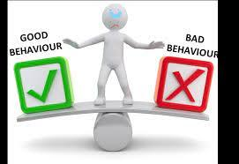
School verwachtingen vs. Gedrag dat uitdaagt
Notes:
Schools are complex organisations, made up of various staff members, children, young people parents, carers and external professionals. It is important to recognise that all of these people may have very different staring positions when thinking about the needs of adopted and care experienced young people. Many may also be dealing with other competing priorities and differing agendas. The process of change can be very difficult hard and changing organisations such as schools requires consistency over a long period of time. The most effective changes that take place are led from the top, so in the example of a school this would be a Head Teacher/School Principal.
In order to develop inclusive environments, schools teams need a significant shift in mindset. This is about taking the first step as a school to think about everything they have tried so far to managed traumatised children’s behaviour.
If you are training teachers or students with working in school experience, you can discuss these 3 key questions:
(1) What have schools (or your school) tried so far? (2) How has it worked in the long term? (3) What has it cost them?
When you are listing what has been tried, put down everything: from things individuals have done to a whole school approach. (see next slide)
If your students have no teaching experience, then explain how some behaviours from traumatised children challenge school expectations

Slide 4
Veel voorkomende reacties vanuit de school op uitdagend gedrag
Nablijven
Waarschuwingen
Negeren
Overtuigen
Ouders/verzorgers bellen
Dreigementen
Aanspreken
Externe hulpverleners inschakelen
Roepen
Overleggen
Isolatie
Puntensysteem Slecht Gedrag
Kind buitensluiten
Willen at het kind weggaat
Publieke vernedering (naam van het kind op het bord)
Notes:
Here is an example of some of the approaches that school may have taken as an individual or as a whole school approach to get a child to change their behaviour.
If a particular strategy was helpful, we would expect to see a decrease in it’s use with a particular child. If we think about detentions for example if they were effective we shouldn’t see that child keep getting detentions because we would expect their behaviour to have changed in response to the first few detentions. When you are thinking about the cost it is also important to consider the impact on people’s emotional well being and resilience. Thinking about the self esteem and self efficacy of both staff and children.
Once you have identified the approaches that are not working it is important for us to ask “why do we keep doing the same thing hoping for a different outcome?”

Slide 5
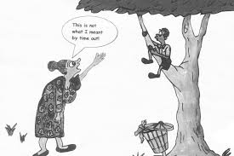
Gedrag dat uitdaagt
Notes:
Traumatised children need relationships that with attachment (A) regulation (R) and competency (C). This is true whether we are providing individualised therapy, therapeutic parenting at home or a healing environment in schools.
Thinking about behaviour as communication is key for teachers, educators and school staff to understand that those children who are so often viewed as naughty are in fact dealing with many complex issues which can only be addressed through whole school understanding and different approaches.
These children do what they do from experience and from what has been learned, not because they feel like being naughty or mean which can so often be the interpretation.
We must accept difficult behaviours as coming from a place of fear and adverse childhood experience not from intentional or wilful behaviour. When there is a lack of understanding as to where this behaviour comes from teachers and the school so often misinterpret the child as being oppositional, defiant and rude
School are complex organisations and so often teachers who are managing classes of up to 30 pupils understandably can get caught up in logging and reacting to these behaviours rather than exploring what the child might be telling us through their behaviour what their needs are.

Slide 6
Negatieve jeugdervaringen
Impact van Negatieve Jeugdervaringen
Hoe ziet dit eruit in gedrag:
Slecht zelfbeeld
Zintuiglijke behoeften
Emotieregulatie Problemen
Gebrekkig Executief Functioneren
Moeizame relaties met volwassenen
Moeizame relaties met leeftijdsgenoten
Omgaan met verandering
Verlies bij overgangen
Leerbehoeften
Constant praten of vragen stellen
Geluid(en) maken
Niet stil kunnen zitten
Stoel, klas of gebouw verlaten
Dingen gooien of kapotmaken
Zichzelf of anderen pijn doen
Dingen pakken die niet van hen zijn
Situaties proberen te besturen
Uitbarstingen van woede of frustratie
Notes:
Many of the children displaying these behaviours probably wont be aware that these behaviours are the things they are feeling and thinking. If we are curious and open to exploring what might be underneath these behaviours we can help start to develop an awareness for themselves.
When we are thinking about these behaviours we need to ask ourselves (1) What the behaviour tells us about the child’s unmet needs such as their emotional and social needs (2) How can we change/adapt the school environment to reduce any of the triggers which may cause the challenging behaviour? (3) How we adjust how we respond to the behaviour which is more helpful to the child?
Next slide – what these behaviours as a means of communication might be telling us – we also need to say a behaviour policy within schools that meets children where they are at

Slide 7
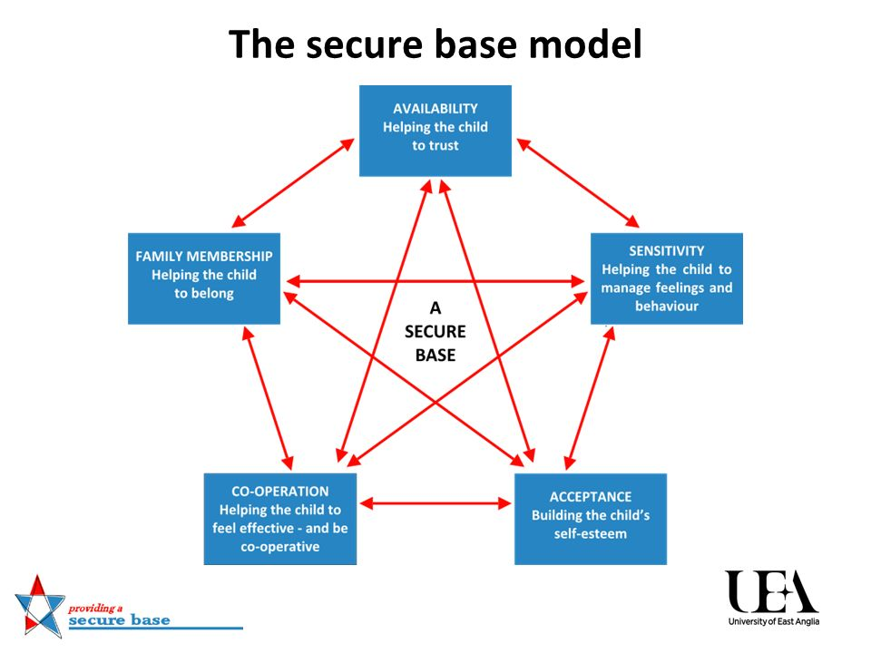
Gedrag als Communicatie
Ik voel me niet veilig
Ik vertrouw jou niet
De enige op wie ik kan rekenen ben ik zelf
Ik weet niet hoe ik me voel
Ik voel me slecht
Ik voel me stom
Ik voel me verdrietig
Ik voel me bedreigd
Ik moet ontsnappen
Ik moet mezelf beschermen
Ik moet controle hebben om me veilig te voelen
Notes:
If we understand all we can about the impact of Adverse Childhood Experiences and how they manifest themselves in behaviour within the school environment we need to ensure that our policies and the environment in which we are expecting these children to learn and thrive meets their needs.
Move to next slide where will we look at behaviour policies

Slide 8
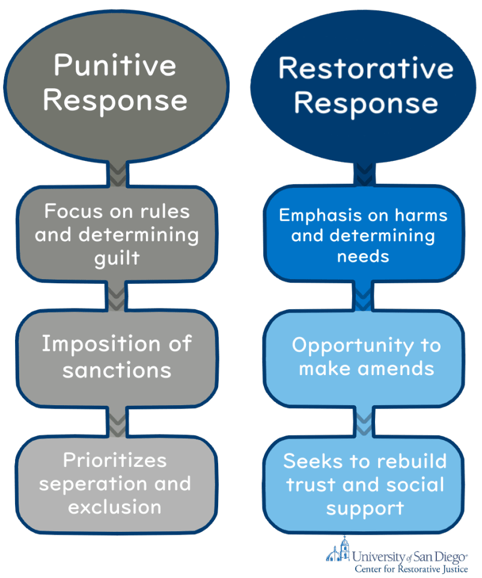
Gedrag Beleid School
Notes:
Behaviourism is the idea that all behaviour can be reduced reaction linked to a response. These links are learned from our environment. In the world of behaviourism, rewards and punishment are not emotive terms, they are simply the things that teach us to do more or less of a particular behaviour. It is understandable then that schools have relied on rewards and punishment to shape children’s behaviour. The difficulty is that behaviourism and social learning theory do not sufficiently take into account attachment or children’s experiences of trauma.
Such systems assume that:
The problem is that chid wont do something, not that they cant. Therefore if we have a system that uses rewards and consequences this will solve the problem
Children are in control of their behaviour and they are not acting impulsively
Children understand cause and effect so will be able to learn from such a system
Children can cope with the punishment from an adult without interpreting this as (I am rubbish)
Children can feel guilt (I did something bad) without feeling Shame (I am bad)
We cannot make this assumption about adopted and care experienced young people as many of their tricky behaviours come from a position of feeling threatened and unsafe
Let us now look at a typical school behaviour policy (bring a couple of examples of school policies to share).
What have we learned about the policies we have read?
Are they behaviourist or are they relationship?
Do you think these policies will work?
What issues can you see within these policies?
Are there aspects of the policies you think might work?
Do they consider the needs of adopted and care experienced young people?
We are now going to work on our own mini policy and think together in our breakout (or whole group depending on size) what needs to be considered within this policy
Recap/Feedback from todays sessions
Can each person tell us something they have learned from todays session?
Is there something from this learning that you will take forward as a teacher in your role?

Slide 9
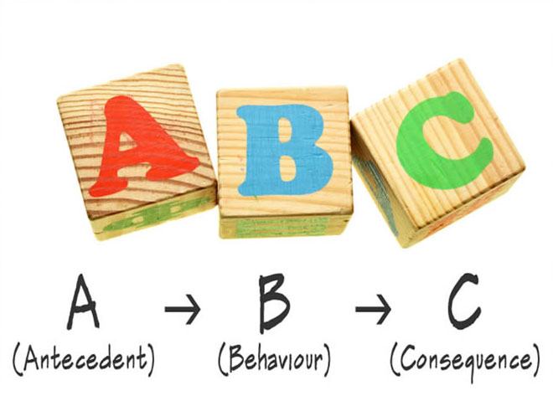
ABC Chart Een observerend hulpmiddel om gedrag mee waar te nemen waardoor we beter kunnen begrijpen wat er gecommuniceerd wordt.
Notes:
We are going to look at something called a Functional Behaviour Analysis Chart or an ABC chart. This is an observational tool that allows you to record a particular behaviour. It enables you to consider the behaviour alongside the schools behaviour policy/ethos and how this might be impacting. It helps us think about what changes we might need to make in school in terms of taking a whole school approach. The aim of using an ABC chart is to help us better understand what the behaviour is communicating. They also include environmental factors that may also be impacting the child or young person negatively.
Refer to lesson script to discuss A Antecedent, B Behaviour and C Consequence
We are going to look at the case study of Ben who has been refusing to complete tasks, is continually running out of lessons and is generally being disruptive to the class.
One you have read the ABC chart in your smaller groups (or large group if not enough numbers to break into sub groups) we are going to answer the following questions which relate to the school environment and strategies that might support this young person in school. One you have done this and thought about the triggers for the behaviour and the consequences which could be maintaining it, you can then use all of this information to help you develop a plan to better support this student
Q1. What changes could you make to the environment around the child to decrease exposure to any triggers?
Q2. What strategies could you teach the student to cope with the triggers better?
Q3. What skill could you teach the student that would reduce their need to engage in a particular behaviour?
Q4. What support can you provide to meet the students needs and thus reduce the need for the behaviour?
Key Adults in school play a vital role for the child in creating a safe base. Key adults can support and help meet the child’s need for availability, sensitivity, acceptance, cooperation and membership.
The role of the key adult
Availability (so the child can learn to trust)
Provide the child with regular predictable “attachment time” which is built into the child daily or weekly timetable
Ensuring this time is fully focused on the child looking and listening to them closely, without being interrupted or distracted
Being reliable and communicating clearly to the child if plans have to change, explaining why and what the new plan is
Making sure the child knows how and is allowed to find the key adult if they are distressed or need help
Seeking out the child if they not ask for or accept help when they are in distress or trouble
Acknowledging and celebrating key milestones for the child including birthday, adoption days or anniversaries and achievements
Keeping in touch over half terms, long holidays and once the child or adult leaves the school
Sensitivity (so the child can understand and manage their feelings and behaviour)
Being aware of the child’s previous experiences, including key triggers and areas of difficulty
Tuning in with genuine curiosity to the child’s feelings, thoughts, needs and wishes
Using validation and empathy to show the child that you are interested in understanding how they feel and in linking this to what is happening around them
Responding to the child’s feeling and needs by acknowledging them and meeting them as appropriate
Helping the child to find ways to express and copy with their feelings and needs
Sharing (appropriately) some of your thoughts, feelings, wishes and need so that the child learns that others also have thoughts and feelings and learns to read these accurately and connect them with what is happening
Acceptance (so the child can develop their self esteem)
Using accepting language that shows the child they are not alone. For example: “We had a tricky day didn’t we? We can sort it out together”
Welcoming the child’s strengths and interests and giving them opportunities to pursue these, with the message “everybody is good at something”
Naming and accepting the different “parts of the child, including the parts that seem contradictory, like “your being silly part” “your working hard part”, ”your sad part” and “your kind part”
Finding ways to show they child the are of value just the way they are
Modelling imperfection and acceptance of yourself (e.g. making a mistake and then speaking compassionately to yourself: “Never mind we all make mistakes”
Encouraging the child to take risks in play and learning, and helping them to accept the fear or making a mistake or getting it wrong
Cooperation (so the child can feel effective)
Finding ways to help the child feel that they are effective and competent and can be autonomous in a developmentally appropriate way
Offering the child choices
Negotiating with clear boundaries
Encouraging child to have a go at activities and tasks for themselves while providing support so they can experience success
Helping the child to feel like part of a team where they have something to contribute, helping you with jobs such as preparation, to working on a project with you
Setting clear limits so that the child can feel to exercise the control they have without the scary sense that they are all powerful or that they are responsible for decisions or events
Membership (so the child can feel they belong)
Creating a sense of being a team together with the child
Helping the child to feel included in other groups and teams, such as their class, clubs, intervention groups, and in the school as a whole, by being acknowledged at assembly or representing the class at a school event
Pointing out what the child has in common with you and with other children and adults in the scho9ol, such as their uniform, neat handwriting, their hair or eye colour and their likes and dislikes
Working with the child’s family to affirm, as appropriate, that children can belong to multiple families (adoptive, foster families, other permanency type families) and that embracing new belonging does not sever previous ties
Reinforcing the child’s sense of belonging with their adoptive family, using photographs, transitional objects from home, books and stories and by talking about the future. “When you all go on holiday next summer…….., when you celebrate Christmas at home………
Helping the child to leave school with clear evidence of their belonging at the school, e.g. a yearbook or “goodbye book” with photographs, messages and contact details for key people

Slide 10
Een positieve band vaststellen en onderhouden
Beschikbaarheid (zodat het kind leert te vertrouwen)
Gevoeligheid (zodat het kind hun gevoelens en gedrag kan begrijpen en besturen)
Acceptatie (zodat het kind hun zelfvertrouwen kan ontwikkelen)
Samenwerking
(zodat het kind zich nuttig voelt)
Deelneming (zodat het kind het gevoel heeft erbij te horen)

Slide 11
NOTES
What does a true partnership involve? What are the potential barriers to the partnership?
When traumatized children are experiencing difficulties, it can place a lot of pressure on the people who are supporting them. Everyone within this network of support can feel high levels of anxiety and we can then sometimes slip into a culture of blame. Parents and carers often tell us that they can sometimes feel to blame for their child’s difficulties and struggles in school, perhaps because there can be a misconception that the child’s difficulties have arisen from poor parenting. Schools, teachers and the “team around d the child” can help such situations by acknowledging that a child’s difficulties may be due to their early life history, not their adopted or foster family or even their adoption or care experience.
Partnerships between parents and school can be even harder when children don’t appear to have any difficulties at school. The school may interpret this as the child being fine whereas the parent/carer knows all too well that the child is managing to hold it together in school and then coming home and letting the stresses spill out. Imagine a bottle of coca cola that has been shaken all day long and at the end of the day and after all of the shaking the lid comes off and the coke spills out everywhere. Many adopters and carers can relate to this analogy
Over compliance can be a particular issue for adopted children. There early life experiences have taught them that the best way to keep themselves safe is to be very very good, but what cannot be seen is the high levels of fear and stress that sit beneath the surface of this over compliance
School Expectations vs. Behaviour that challenges
Schools are complex organisations, made up of various staff members, children, young people parents, carers and external professionals. It is important to recognise that all of these people may have very different staring positions when thinking about the needs of adopted and care experienced young people. Many may also be dealing with other competing priorities and differing agendas. The process of change can be very difficult hard and changing organisations such as schools requires consistency over a long period of time. The most effective changes that take place are led from the top, so in the example of a school this would be a Head Teacher/School Principal.
In order to develop inclusive environments, schools teams need a significant shift in mindset. This is about taking the first step as a school to think about everything they have tried so far to managed traumatised children’s behaviour.
If you are training teachers or students with working in school experience, you can discuss these 3 key questions:
(1) What have schools (or your school) tried so far? (2) How has it worked in the long term? (3) What has it cost them?
When you are listing what has been tried, put down everything: from things individuals have done to a whole school approach. (see next slide)
If your students have no teaching experience, then explain how some behaviours from traumatised children challenge school expectations.
Common Responses in schools to Challenging behaviour
Here is an example of some of the approaches that school may have taken as an individual or as a whole school approach to get a child to change their behaviour.
If a particular strategy was helpful, we would expect to see a decrease in it’s use with a particular child. If we think about detentions for example if they were effective we shouldn’t see that child keep getting detentions because we would expect their behaviour to have changed in response to the first few detentions. When you are thinking about the cost it is also important to consider the impact on people’s emotional well being and resilience. Thinking about the self esteem and self efficacy of both staff and children.
Once you have identified the approaches that are not working it is important for us to ask “why do we keep doing the same thing hoping for a different outcome?”
Behaviour that Challenges
Traumatised children need relationships that with attachment (A) regulation (R) and competency (C). This is true whether we are providing individualised therapy, therapeutic parenting at home or a healing environment in schools.
Thinking about behaviour as communication is key for teachers, educators and school staff to understand that those children who are so often viewed as naughty are in fact dealing with many complex issues which can only be addressed through whole school understanding and different approaches.
These children do what they do from experience and from what has been learned, not because they feel like being naughty or mean which can so often be the interpretation.
We must accept difficult behaviours as coming from a place of fear and adverse childhood experience not from intentional or wilful behaviour. When there is a lack of understanding as to where this behaviour comes from teachers and the school so often misinterpret the child as being oppositional, defiant and rude
School are complex organisations and so often teachers who are managing classes of up to 30 pupils understandably can get caught up in logging and reacting to these behaviours rather than exploring what the child might be telling us through their behaviour what their needs are.

Slide 12
Adverse Childhood Experiences
Many of the children displaying these behaviours probably wont be aware that these behaviours are the things they are feeling and thinking. If we are curious and open to exploring what might be underneath these behaviours we can help start to develop an awareness for themselves.
When we are thinking about these behaviours we need to ask ourselves (1) What the behaviour tells us about the child’s unmet needs such as their emotional and social needs (2) How can we change/adapt the school environment to reduce any of the triggers which may cause the challenging behaviour? (3) How we adjust how we respond to the behaviour which is more helpful to the child?
Next slide – what these behaviours as a means of communication might be telling us – we also need to say a behaviour policy within schools that meets children where they are at.
Behaviour as Communication
If we understand all we can about the impact of Adverse Childhood Experiences and how they manifest themselves in behaviour within the school environment we need to ensure that our policies and the environment in which we are expecting these children to learn and thrive meets their needs.
Move to next slide where will we look at behaviour policies.
School Behaviour Policies
Behaviourism is the idea that all behaviour can be reduced reaction linked to a response. These links are learned from our environment. In the world of behaviourism, rewards and punishment are not emotive terms, they are simply the things that teach us to do more or less of a particular behaviour. It is understandable then that schools have relied on rewards and punishment to shape children’s behaviour. The difficulty is that behaviourism and social learning theory do not sufficiently take into account attachment or children’s experiences of trauma.
Such systems assume that:
The problem is that chid wont do something, not that they cant. Therefore if we have a system that uses rewards and consequences this will solve the problem
Children are in control of their behaviour and they are not acting impulsively
Children understand cause and effect so will be able to learn from such a system
Children can cope with the punishment from an adult without interpreting this as (I am rubbish)
Children can feel guilt (I did something bad) without feeling Shame (I am bad)
We cannot make this assumption about adopted and care experienced young people as many of their tricky behaviours come from a position of feeling threatened and unsafe
Let us now look at a typical school behaviour policy (bring a couple of examples of school policies to share).
What have we learned about the policies we have read?
Are they behaviourist or are they relationship?
Do you think these policies will work?
What issues can you see within these policies?
Are there aspects of the policies you think might work?
Do they consider the needs of adopted and care experienced young people?
We are now going to work on our own mini policy and think together in our breakout (or whole group depending on size) what needs to be considered within this policy.
ABC chart
We are going to look at something called a Functional Behaviour Analysis Chart or an ABC chart. This is an observational tool that allows you to record a particular behaviour. It enables you to consider the behaviour alongside the schools behaviour policy/ethos and how this might be impacting. It helps us think about what changes we might need to make in school in terms of taking a whole school approach. The aim of using an ABC chart is to help us better understand what the behaviour is communicating. They also include environmental factors that may also be impacting the child or young person negatively.
You can use a case study (such of Ben’s case) to deep in the use of the ABC Chart. who has been refusing to complete tasks, is continually running out of lessons and is generally being disruptive to the class.
One you have read the ABC chart in your smaller groups (or large group if not enough numbers to break into sub groups) we are going to answer the following questions which relate to the school environment and strategies that might support this young person in school. One you have done this and thought about the triggers for the behaviour and the consequences which could be maintaining it, you can then use all of this information to help you develop a plan to better support this student
Q1. What changes could you make to the environment around the child to decrease exposure to any triggers?
Q2. What strategies could you teach the student to cope with the triggers better?
Q3. What skill could you teach the student that would reduce their need to engage in a particular behaviour?
Q4. What support can you provide to meet the students needs and thus reduce the need for the behaviour?
Establishing and maintaining a positive relationship
Key Adults in school play a vital role for the child in creating a safe base. Key adults can support and help meet the child’s need for availability, sensitivity, acceptance, cooperation and membership.
The role of the key adult includes:

Slide 13
Availability (so the child can learn to trust)
Provide the child with regular predictable “attachment time” which is built into the child daily or weekly timetable
Ensuring this time is fully focused on the child looking and listening to them closely, without being interrupted or distracted
Being reliable and communicating clearly to the child if plans have to change, explaining why and what the new plan is
Making sure the child knows how and is allowed to find the key adult if they are distressed or need help
Seeking out the child if they not ask for or accept help when they are in distress or trouble
Acknowledging and celebrating key milestones for the child including birthday, adoption days or anniversaries and achievements
Keeping in touch over half terms, long holidays and once the child or adult leaves the school
Sensitivity (so the child can understand and manage their feelings and behaviour)
Being aware of the child’s previous experiences, including key triggers and areas of difficulty
Tuning in with genuine curiosity to the child’s feelings, thoughts, needs and wishes
Using validation and empathy to show the child that you are interested in understanding how they feel and in linking this to what is happening around them
Responding to the child’s feeling and needs by acknowledging them and meeting them as appropriate
Helping the child to find ways to express and copy with their feelings and needs
Sharing (appropriately) some of your thoughts, feelings, wishes and need so that the child learns that others also have thoughts and feelings and learns to read these accurately and connect them with what is happening
Acceptance (so the child can develop their self esteem)
Using accepting language that shows the child they are not alone. For example: “We had a tricky day didn’t we? We can sort it out together”
Welcoming the child’s strengths and interests and giving them opportunities to pursue these, with the message “everybody is good at something”
Naming and accepting the different “parts of the child, including the parts that seem contradictory, like “your being silly part” “your working hard part”, ”your sad part” and “your kind part”
Finding ways to show they child the are of value just the way they are
Modelling imperfection and acceptance of yourself (e.g. making a mistake and then speaking compassionately to yourself: “Never mind we all make mistakes”
Encouraging the child to take risks in play and learning, and helping them to accept the fear or making a mistake or getting it wrong
Cooperation (so the child can feel effective)
Finding ways to help the child feel that they are effective and competent and can be autonomous in a developmentally appropriate way
Offering the child choices
Negotiating with clear boundaries
Encouraging child to have a go at activities and tasks for themselves while providing support so they can experience success
Helping the child to feel like part of a team where they have something to contribute, helping you with jobs such as preparation, to working on a project with you
Setting clear limits so that the child can feel to exercise the control they have without the scary sense that they are all powerful or that they are responsible for decisions or events
Membership (so the child can feel they belong)
Creating a sense of being a team together with the child
Helping the child to feel included in other groups and teams, such as their class, clubs, intervention groups, and in the school as a whole, by being acknowledged at assembly or representing the class at a school event
Pointing out what the child has in common with you and with other children and adults in the scho9ol, such as their uniform, neat handwriting, their hair or eye colour and their likes and dislikes
Working with the child’s family to affirm, as appropriate, that children can belong to multiple families (adoptive, foster families, other permanency type families) and that embracing new belonging does not sever previous ties
Reinforcing the child’s sense of belonging with their adoptive family, using photographs, transitional objects from home, books and stories and by talking about the future. “When you all go on holiday next summer…….., when you celebrate Christmas at home………
Helping the child to leave school with clear evidence of their belonging at the school, e.g. a yearbook or “goodbye book” with photographs, messages and contact details for key people

